Slide 1
Lecture 1: Why we model
Chapter 1
The Unified Modeling Language User Guide
SECOND EDITION
By Grady Booch, James Rumbaugh, Ivar Jacobson

Slide 2
What is a System?
A system has a specific set of objectives.
Components of a system work together to achieve the objectives of the system within a limited boundary.
Components are given a specific set of tasks/ responsibilities.
Components can perform their responsibilities independently.
Components are related with each other and communicate with each other based on the type of the relationships.
Communication among components take place only on need basis to transfer the output of one component to another component.

Slide 3
Quality of a System
Objectives must be well defined and specific
Components must have well defined and specific responsibilities that they can perform independently.
Communication among components should be as minimum as possible; only on need basis.

Slide 4
Why we model?
Modelling is a proven and well-accepted engineering technique.
Unsuccessful software projects fail in their own unique ways, but all successful projects are alike in many ways.
There are many elements that contribute to a successful software organization; one common thread is the use of modelling.
We do model so that we can better understand the system we are developing.

Slide 5
What is a Model?
A model is a simplification of reality
A model provides the blueprints of a system.
Benefits of Model:
Through modelling we achieve four aims:
Models help us to visualize a system as it is or as we want it to be
Models permit us to specify the structure or behaviour of a system
Models give us a template that guides us in constructing a system
Models document the decisions we have made

Slide 6
Limitation of Human Ability
The larger and more complex the system, the more important modelling becomes, for one very simple reason:
We build models of complex systems because we cannot comprehend such a system in its entirety.
There are limits to the human ability to understand complexity. Through modelling we narrow the problem we are studying by focusing on only one aspect at a time.

Slide 7
Principles of Modelling
1. The choice of what models to create has a profound influence on how a problem is attacked and how a solution is shaped.
In other words, choose models intelligently. The right models will illuminate the wicked development problems.
2. Every model may be expressed at different levels of precision.
Sometimes a quick and simple executable model of the user interface is exactly what you need; at other times, one has to get down and dirty with the bits. In any case, the best kinds of models are those that let you choose your degree of detail, depending on who is viewing and why they need to view it.

Slide 8
Principles of Modelling
3. The best models are connected to reality.
A Model connected to reality makes it more understandable and presentable. The more abstract a model is the more it needs to be closer to reality.
4. No single model is sufficient.
Every nontrivial system is best approached through a small set of nearly independent models.

Slide 9
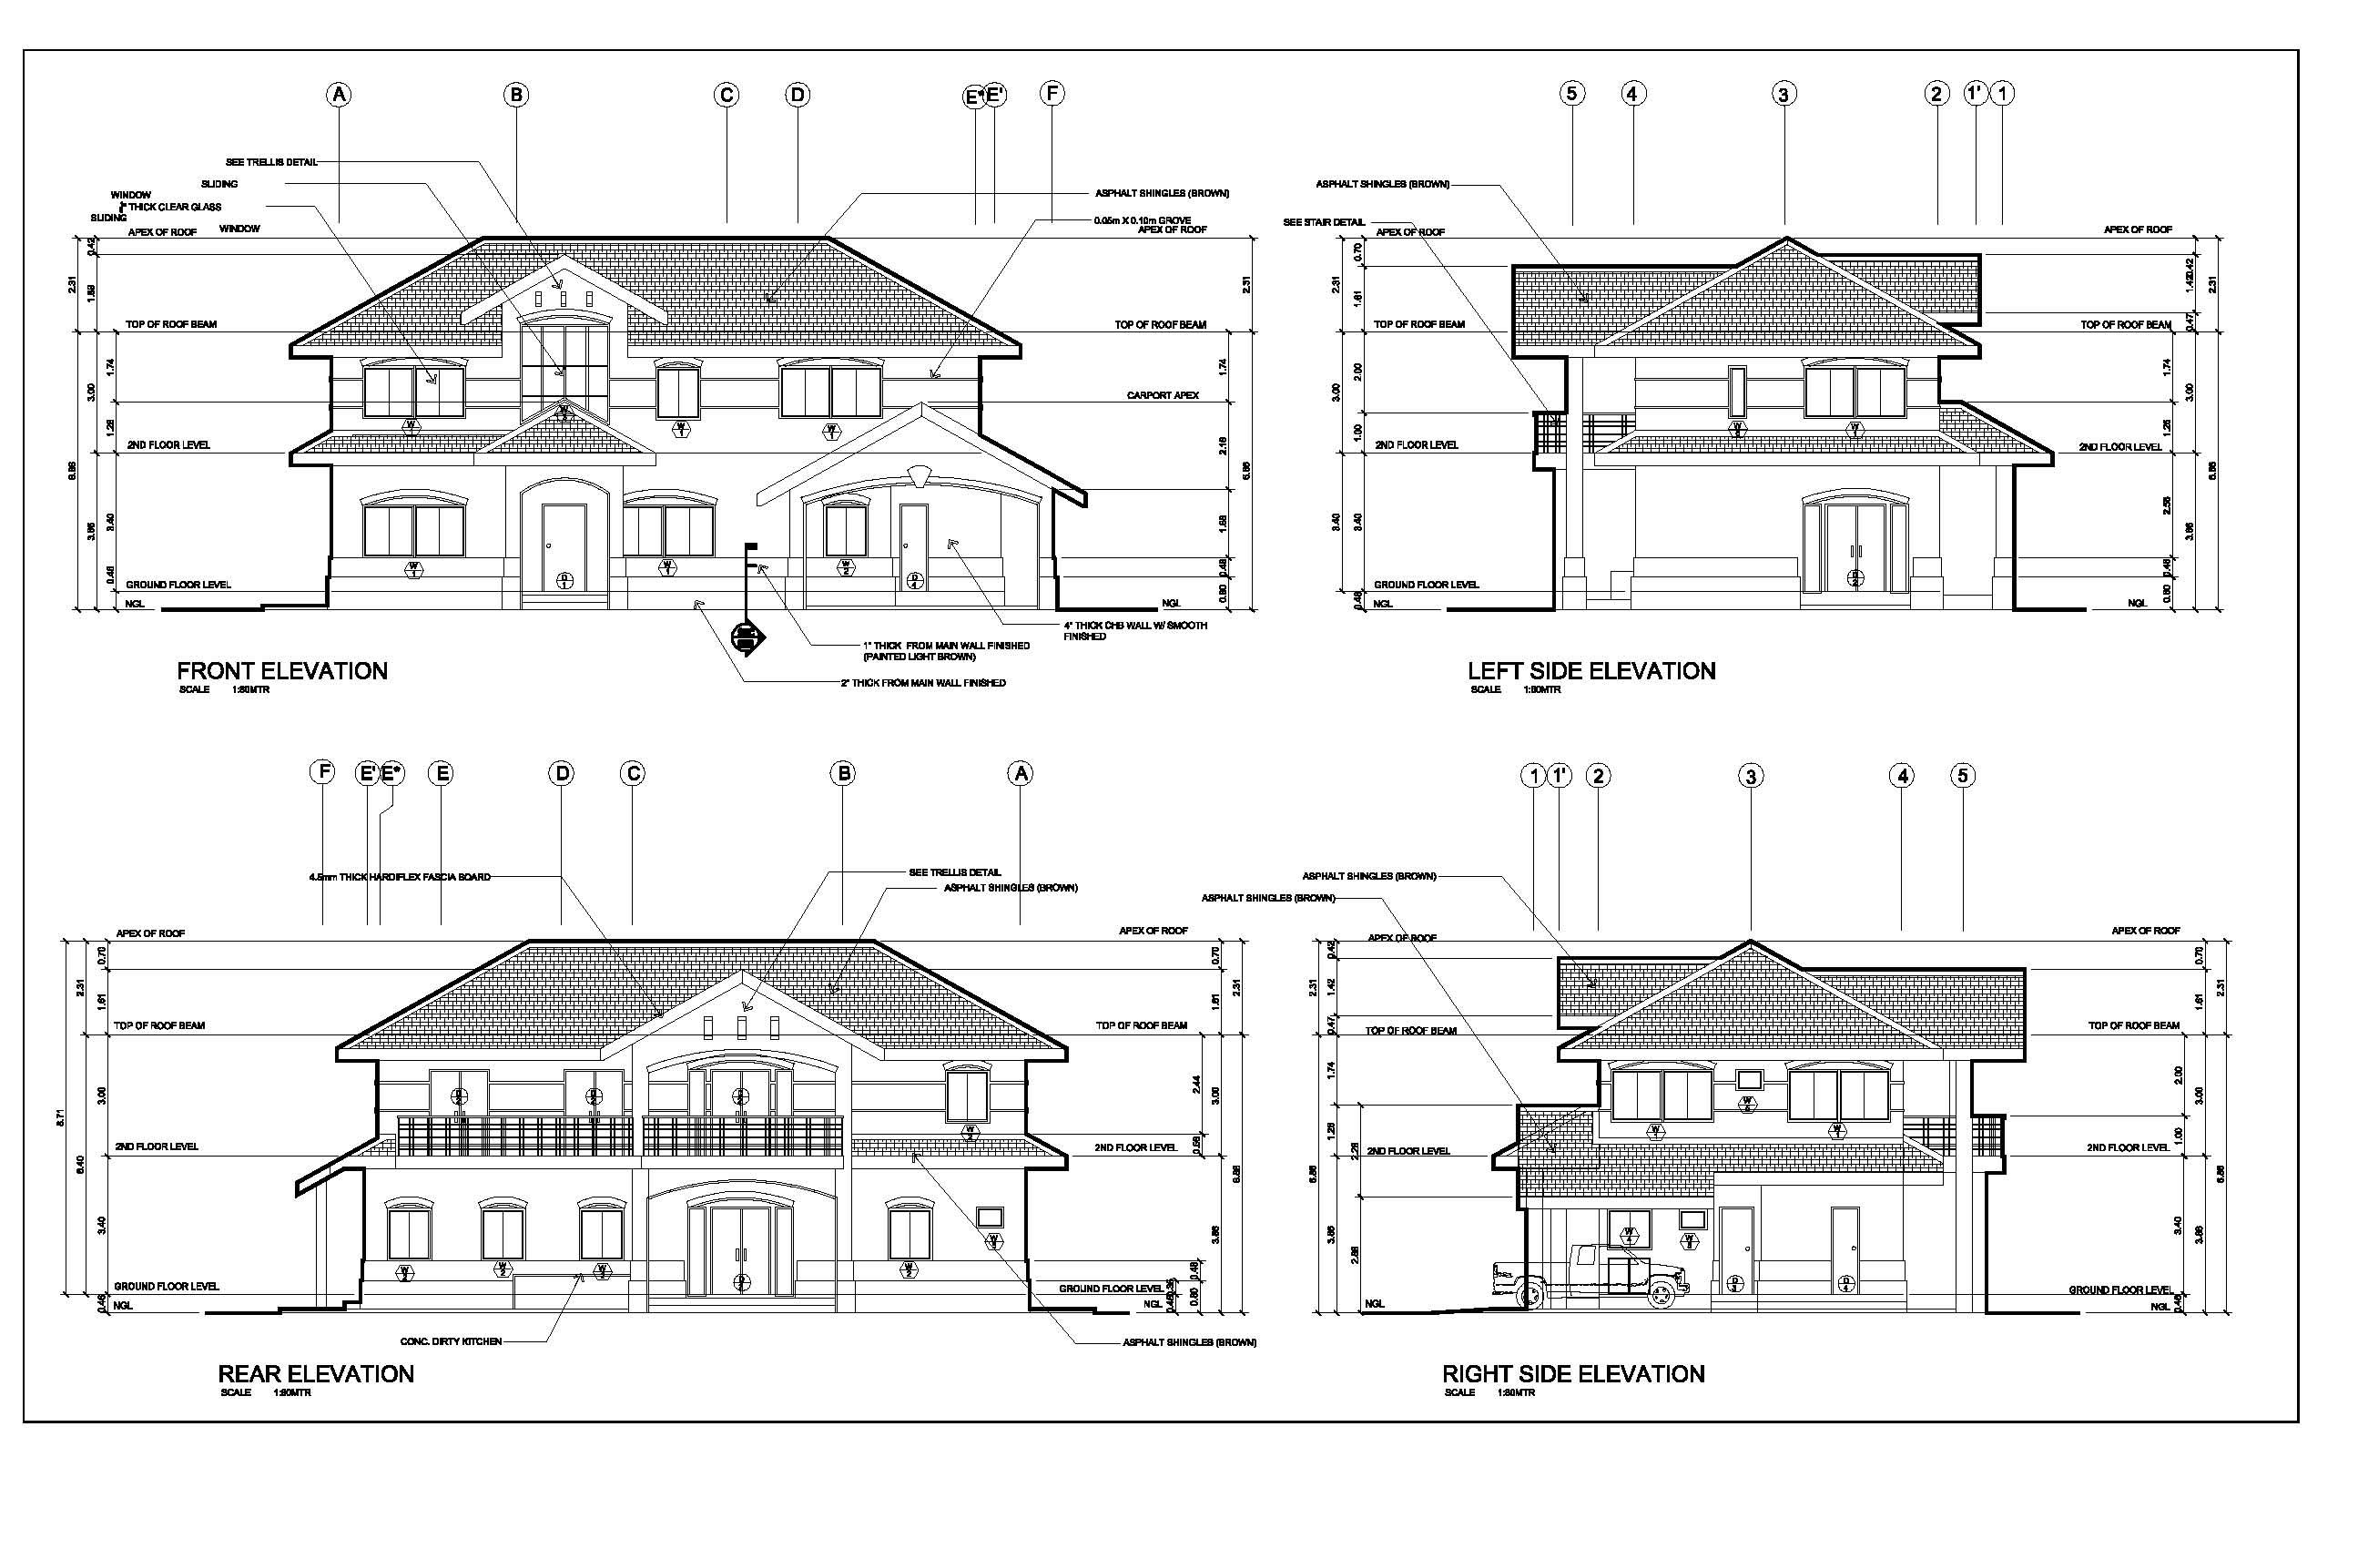
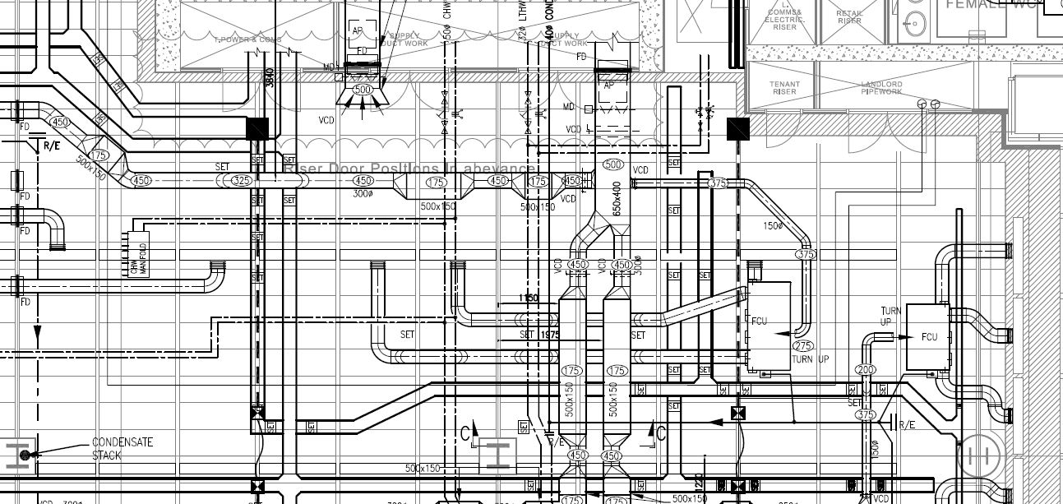
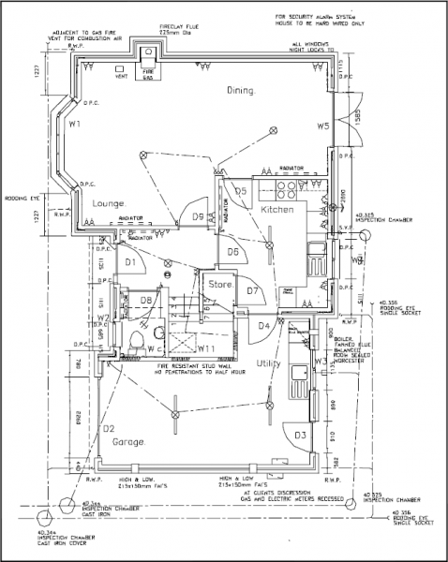
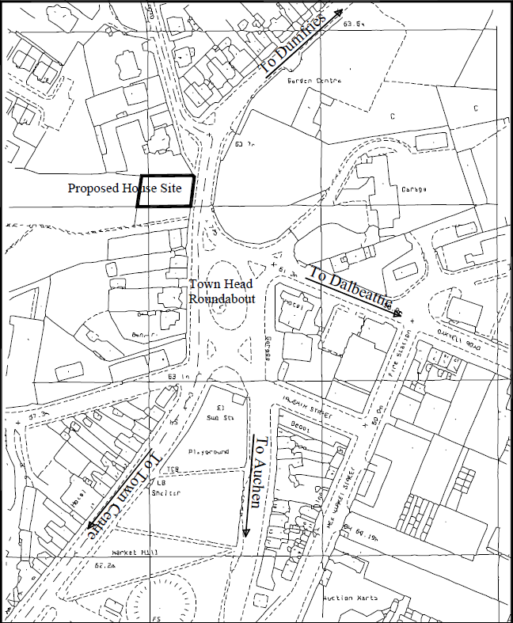
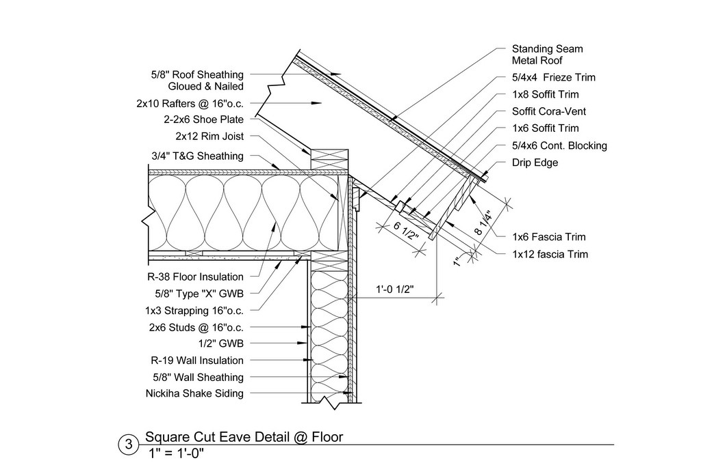

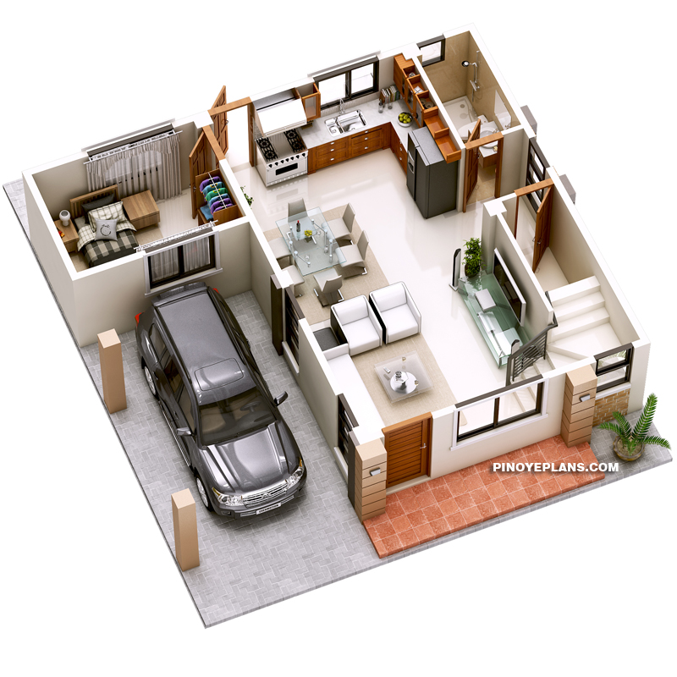
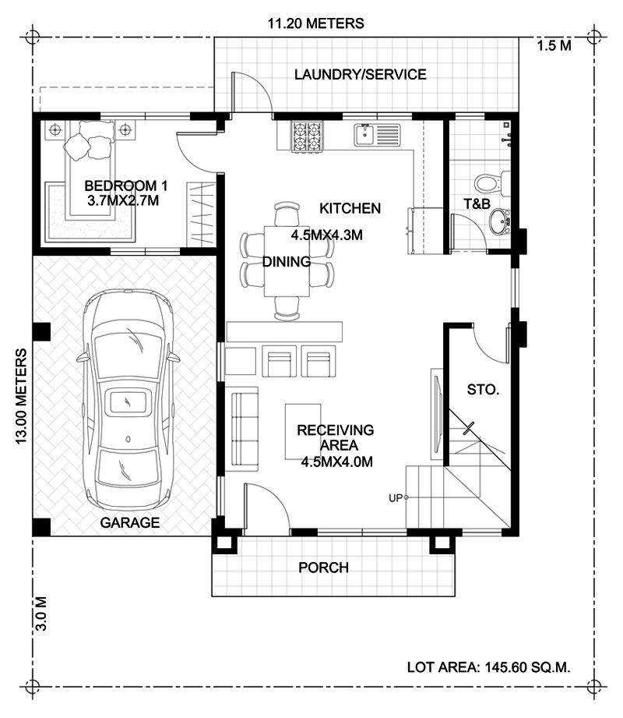
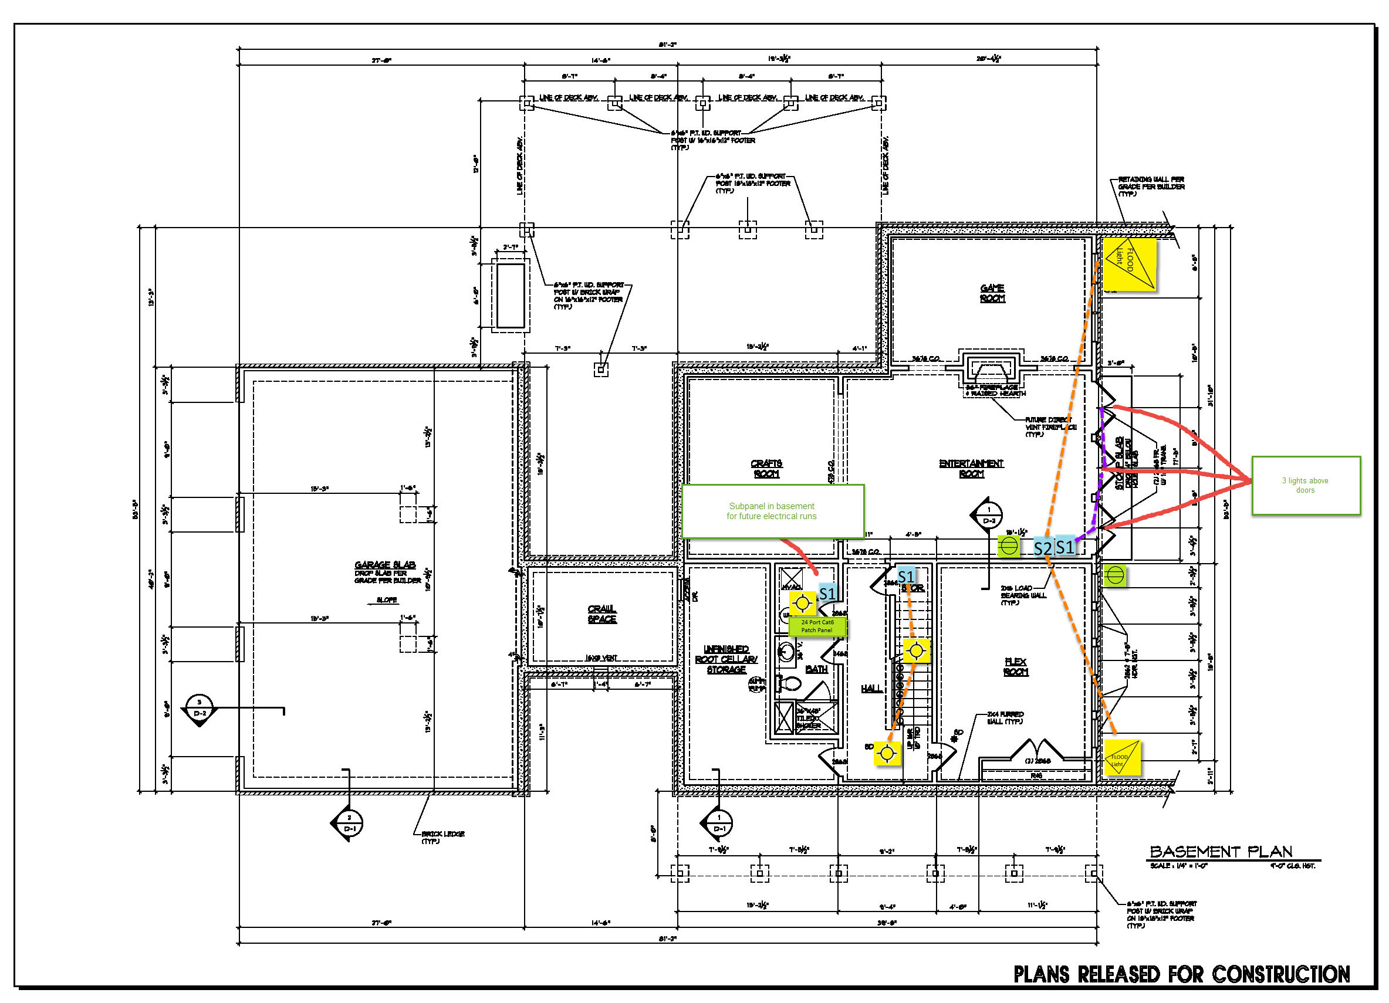
Perspective of design - example

